Slide 1
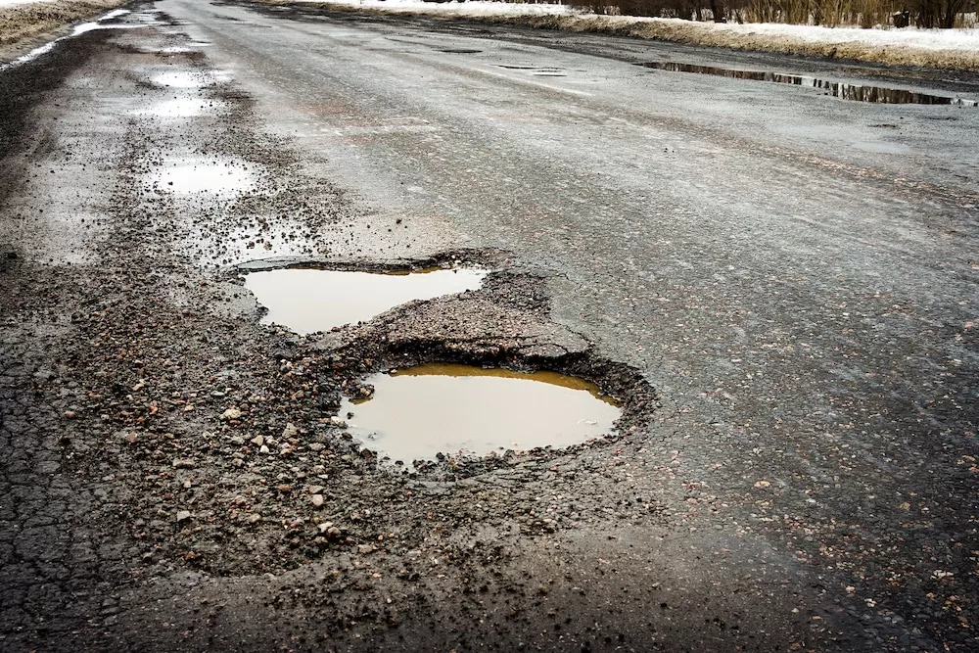
POTHOLE DETECTION AND SEGMENTATION USING U-NET
ECD481 - MINIPROJECT
Karthika S
Shreya Mariam Thomas
Stefin Shiby George

Slide 2
Abstract
Potholes pose a significant safety hazard to vehicles and infrastructure, leading to accidents, damage, and costly repairs.
This presentation explores the use of deep learning, specifically the U-Net architecture, for detecting and segmenting potholes in real-world scenarios.

Slide 3
Introduction to Potholes: Challenges and Importance
SAFETY HAZARDS
INFRASTRUCTURE DEGRADATION
ECONOMIC IMPACT
PUBLIC SAFETY

Slide 4
DATASET PREPARATION AND PROCESSING
DATA ACQUISITION :
Collecting a diverse set of images and videos containing potholes from various road
conditions and perspectives.
IMAGE ANNOTATION :
Labeling the potholes in each image with bounding boxes or segmentation masks,
providing ground truth for the model training.
DATA AUGMENTATION :
Expanding the dataset by applying transformations like rotation, scaling, and flipping
to increase the model's robustness.
DATA SPLITTING :
Dividing the annotated dataset into training, validation, and testing sets to evaluate the model
performance.
DATA NORMALIZATION :
Scaling the image pixel values to a specific range, typically between 0 and 1, for better model
performance.

Slide 5
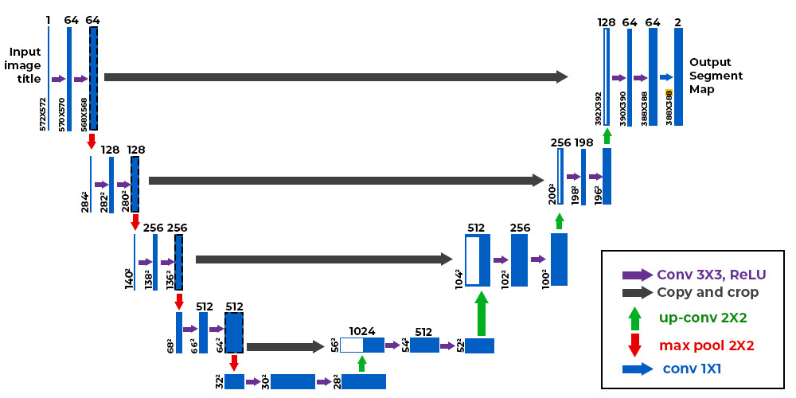
U-NET ARCHITECTURE
The U-Net architecture consists of an encoder and a decoder, each composed of convolutional layers.
The encoder down-samples the input image, extracting high-level features
The decoder up-samples the features, reconstructing the segmented image.

Slide 6
U-NET MODEL TRAINING AND OPTIMIZATION
Build Model
Setup the U Net Architecture
Compile
Loss Function - “Cross Entropy”
Fit
Training for 25 Epochs
Optimiser - “Adam”
Metrics for evaluation – “Accuracy”
Accuracy = 90.3%

Slide 7
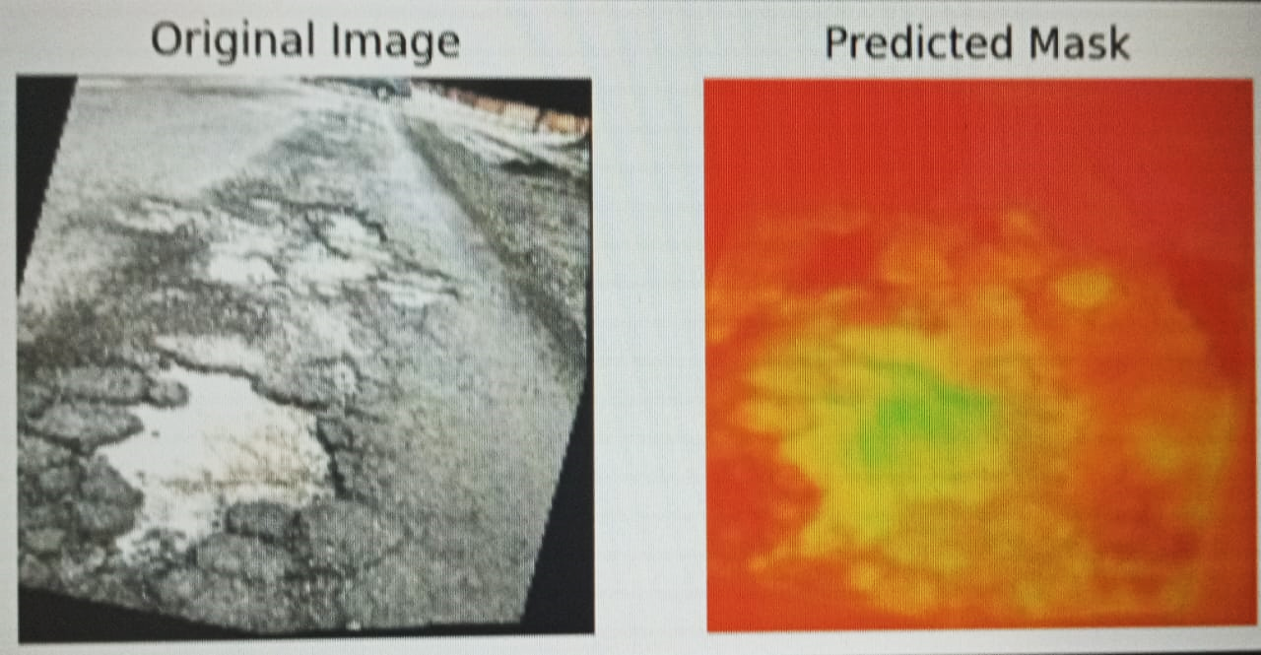
RESULT

Slide 8
FUTURE DIRECTIONS
Future research directions include exploring more robust and efficient deep learning models, incorporating multi-sensor data, and developing adaptive algorithms for real-time pothole detection and repair.
Integrating the U-Net model into real-time systems, such as autonomous vehicles and smart road infrastructure, can significantly improve road safety and reduce maintenance costs.

Slide 9
CONCLUSION
The U-Net model has demonstrated its effectiveness in accurately detecting and segmenting potholes in various road conditions, paving the way for more efficient road maintenance and safety.

